Slide 1
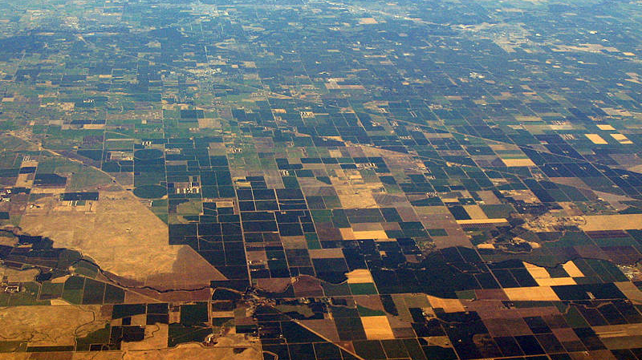
Valley Fever Environmental
Felix, Le, Sanaa, Austin
Notes:
Speaker: Austin - Introduce our group
Hello everyone, I’m Austin
…
And today, we’re going to talk about our Valley Fever Environmental project.

Slide 2
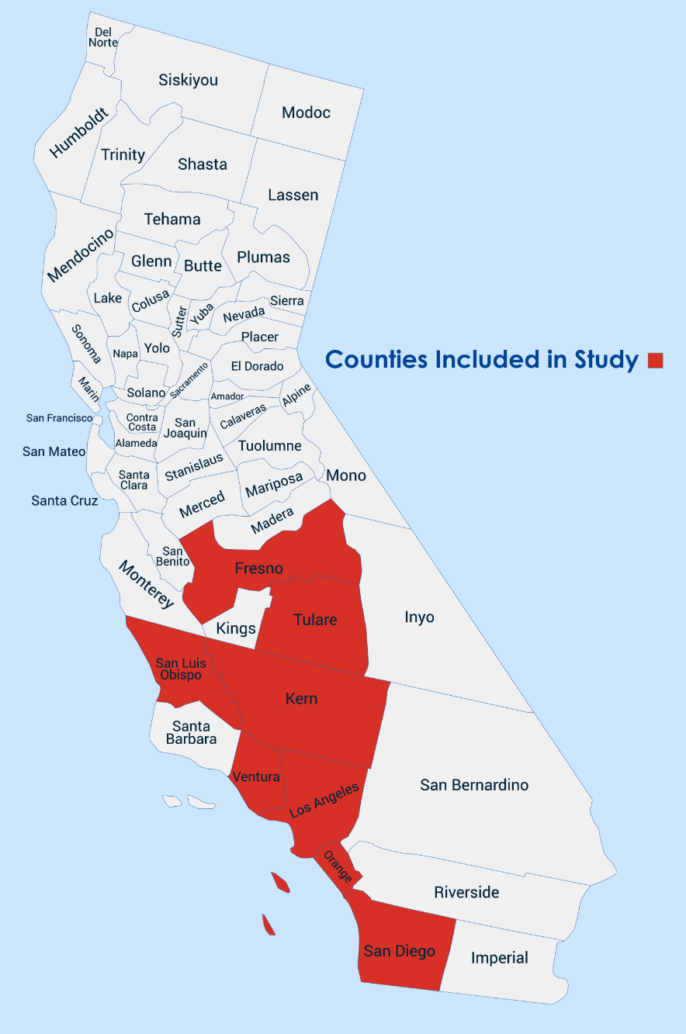
Background
Coccidioidomycosis
Data
A fungal infectious disease endemic to the southwestern United States. It spreads when soil containing the fungus Coccidioides is disturbed and its spores are inhaled. Its symptoms are similar to the flu or COVID-19.
8 counties in CA
Monthly data, 2001-2024
Target: Valley Fever case rates per 100k
Features: precipitation, humidity, wind speed, soil temperature, AQI, fire, fungicide, rodenticide
Fungicide/Rodenticide
01-2001
12-2023
Fire
08-2006
12-2024
All other variables
01-2001
08-2006
12-2023
12-2024
Notes:
Speaker: Austin - Explain VF background
So what is Valley Fever?
Scientific name: Cock-see-deo - ido - mycosis is a fungal infectious disease endemic to the southwestern United States.
It spreads when soil containing the fungus is disturbed and its spores are inhaled and causes symptoms similar to the flu or COVID 19.
[SHORT PAUSE]
Our data consists of 8 counties in CA, shown in the map on the right.
We have monthly variables from 2001-2024, which is one of the largest datasets known to be used in this work.
Our target variable is the Valley Fever case rates per 100k county residents
And our features include precipitation, humidity, wind speed, soil temp, AQI, fire, fungicide, and rodenticide.
[PAUSE]
before we used our data, we had to address a limitation within our dataset.
The diagram in the bottom shows the years for which we had data on fungicide, rodenticide, fire, and all other variables.
Our fire data only ran from 2006 onwards, while our fungicide and rodenticide data only ran until 2023.
Now, there are a number of ways to deal with this missing data, such as using predictions to fill them in, but what we decided on a simpler approach,
which was trimming off the years we didn’t have data for, as we found this would be just as effective for our work.
We also applied a log1p transformation to our target variable before using it in our models.

Slide 3
Our Research
Questions We’re Answering
Why We Should Care
Which environmental variables are most associated with changes in future case rates?
Can our forecasting models generalize across CA counties?
Can we create effective regional models based off coastal/inland counties?
More than 20,000 VF cases are reported in the U.S. each year, with the number only growing. While symptoms are usually mild, a small portion of cases are severe and even an even smaller portion result in death.
Through predictions we can anticipate outbreaks and case surges before they occur, allowing us to employ effective action.
We may also enact policy to help spread awareness and knowledge of the disease.
Notes:
Speaker: __Sanaa__
Here, we are setting up the main goal of the project. So What are the questions were answering with our research ?
Which environmental variables are most associated with changes in future case rates?
Can our forecasting models generalize across CA counties?
Can we create effective regional models based off coastal/inland counties?
and why we should care
More than 20,000 VF cases are reported in the U.S. each year, with the number only growing. While symptoms are usually mild, a small portion of cases are severe and even an even smaller portion result in death.
Through predictions we can anticipate outbreaks and case surges before they occur, allowing us to employ effective action.
We can help enforce policy to help spread awareness and knowledge of the disease.

Slide 4
Testing Model Generalization
County-by-County Models:
LSTM, AR
Statewide Models:
LSTM, SARIMAX
Train On:
County Data
Statewide Data
County Data
(Fresno–Ventura)
Test On:
Compare Metrics/Performance
Notes:
Speaker: ___felix___
We compared models built for individual counties against models trained on statewide patterns, then evaluated how well they transferred back to counties.
Statewide data is the average of the 8 county observations for all the months
LSTM = long short-term memory

Slide 5
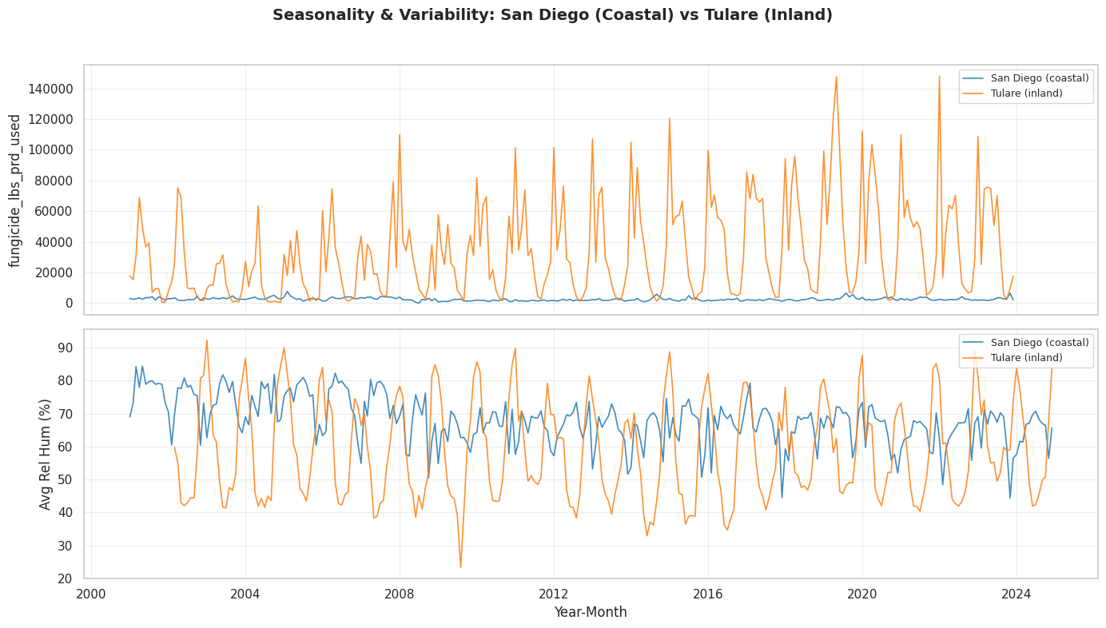
County-wise Exploration
Before picking a model, we had to understand how differently counties behave.
Fungicide use:
Tulare shows huge seasonal spikes up to 140k lbs.
San Diego stays near zero year-round.
Humidity:
San Diego stays consistently high (50-80%).
Tulare swings much wider (25-90%).
This made feature selection hard because a variable that's highly informative in one county is almost meaningless in another, so no single feature set worked everywhere
Notes:
Speaker: __Felix____
Before picking a model, we had to understand how differently counties behave
a coastal county and an inland county don't respond to the same variables the same way
Fungicide use: Tulare (inland) shows huge seasonal spikes up to 140k lbs; San Diego (coastal, urban) stays near zero year-round
Humidity: San Diego stays consistently high (60-80%) with some swings; Tulare swings much wider (25-90%) with sharp seasonal dropsa and spikes
This made feature selection hard — a variable that's highly informative in one county (like fungicide in Tulare) is nearly meaningless in another (San Diego), so no single feature set worked everywhere
That's what led us to test 3 different feature strategies instead of one

Slide 6
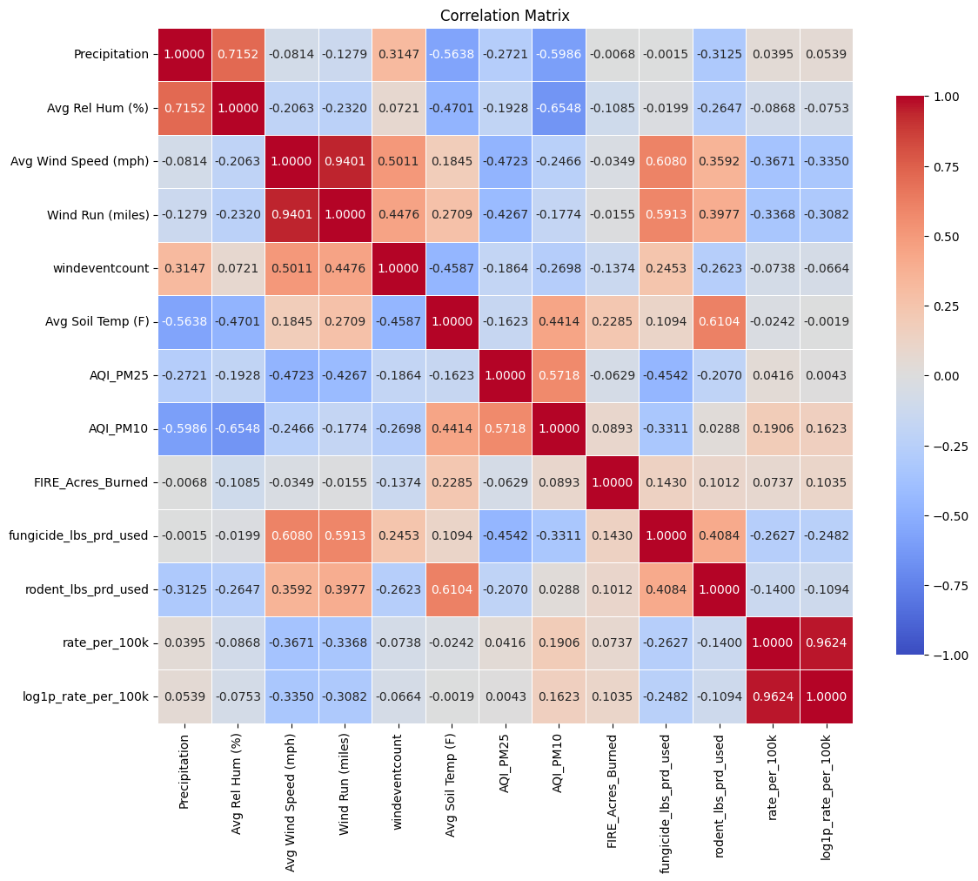
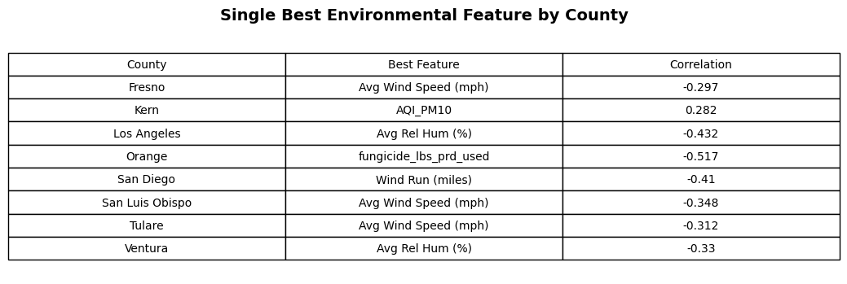
Feature Selection Process
For each county we tried 3 different feature sets:
All exogenous variables
AQI (PM10), Wind Speed and Fungicide
The single best feature for each county
Notes:
Speaker: __ Le___
All variables: test whether the model benefits from full environmental context
Shared top 3: AQI PM 10, wind speed, fungicide (most correlated features), see if we can generally just use these features and still get
good predictions
county-specific best feature: test whether each county has different strongest predictors

Slide 7
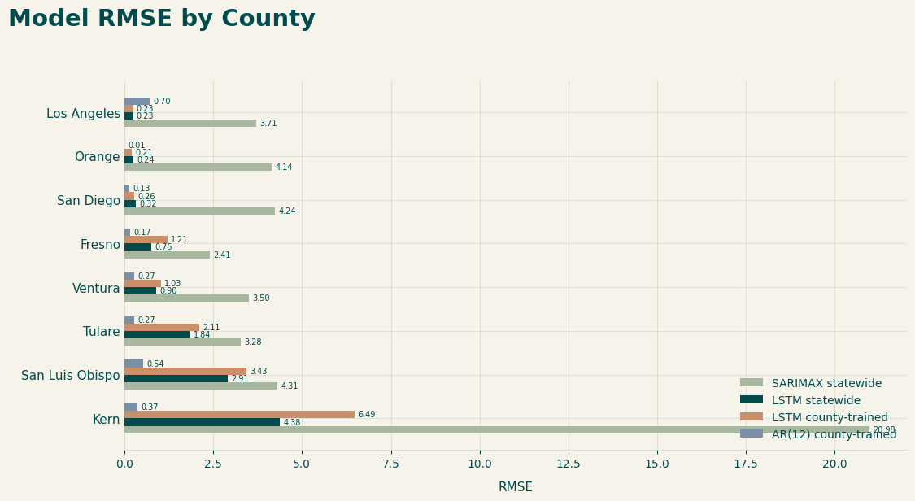
Model Comparison
How models performed across counties
Statewide LSTM beat statewide SARIMAX across every county.
County-trained LSTM did not consistently improve over statewide LSTM.
AR(12) was a good baseline.
Kern remained the hardest county to forecast across models.
Notes:
Speaker: _Sanaa_
we are comparing whether statewide training can still work at the county level.
Upon first glance you can see that the statewide LSTM model beat statewide SARIMAX in every county. But the county-trained LSTM did not automatically improve the results. In several counties the statewide LSTM actually did better.
We think Autoregressive model is a good baseline because of its simplicity
Kern county was the outlier in every model. THIS was a problem with previous work too so we need to work on that
Sanaa vs Félix
. We are asking where each model succeeds or fails, and whether statewide training helps or hurts county-level forecasting
Include a snippet of the large spreadsheet we made with RMSE, MAE etc
Talk about our findings (WE STILL NEED TO DO)

Slide 8
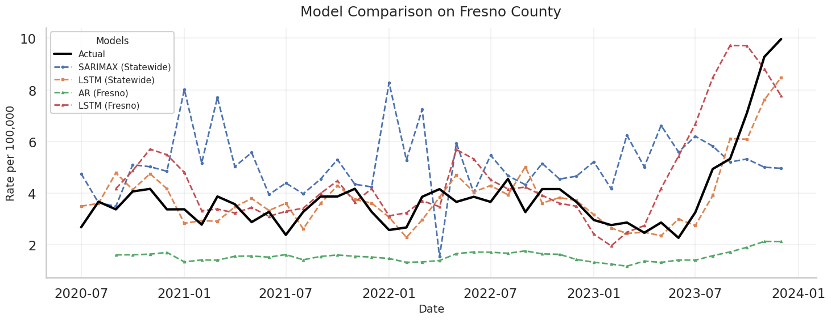
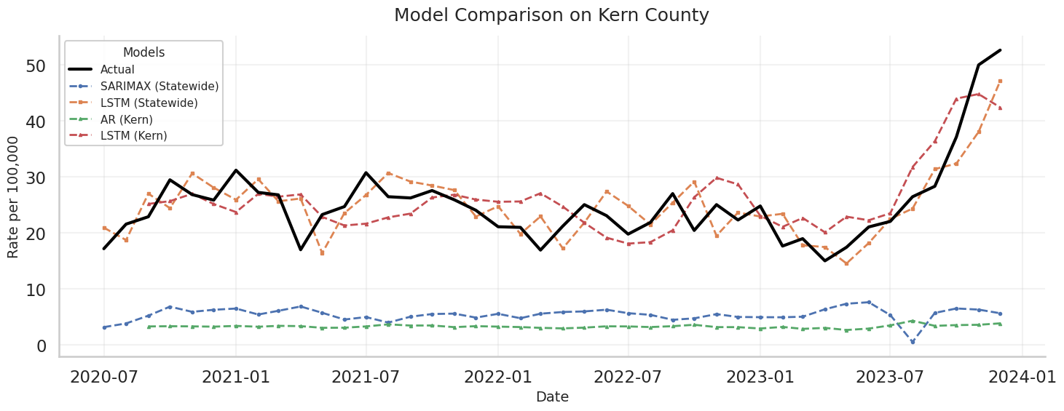
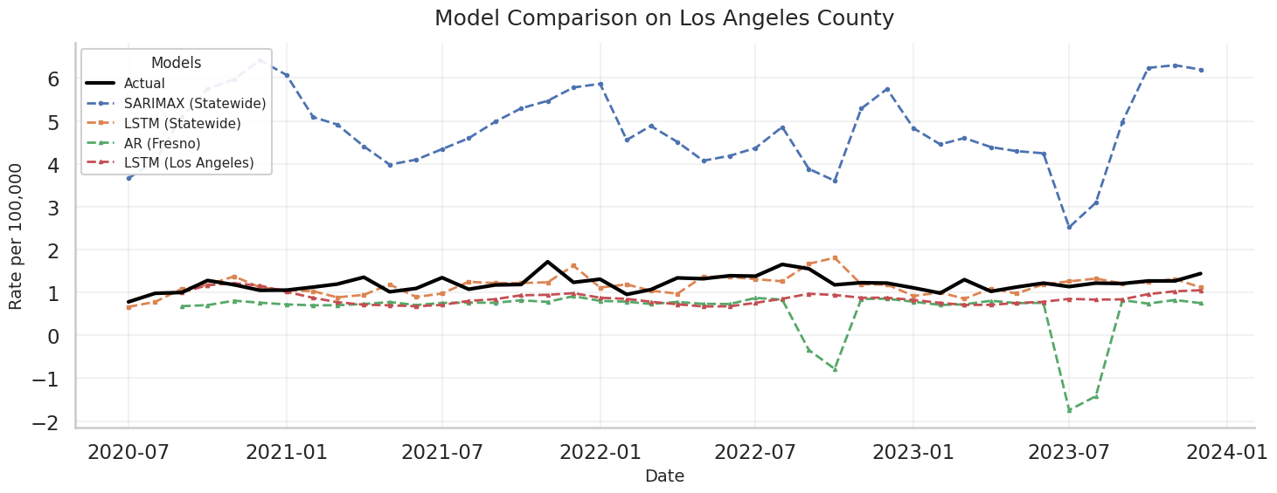
Example
Model Predictions for Fresno, Kern, LA County
Notes:
Speaker: __Austin_____
Here are graphs for three different counties we tested our models on:
Fresno, Kern, and Los Angeles.
The blue represents our SARIMAX model trained on statewide data, and the green represents our AR model trained on county data.
As you can see, they didn’t perform that well on the test data, which was expected.
Next, the orange represents our LSTM model trained on statewide data, and the red represents our LSTM model trained on the county data.
These models performed quite well, without overfitting.
They captured all the trends and seasonality of the data, as well as significant spikes and drops.
In fact, our statewide LSTM model did just as well, if not better than our county model, which proves to be an interesting discovery.
This example shows whether models track timing magnitude or just general trend.
Even when RMSE is similar, the prediction behavior may differ (e.g. some capture large spikes some do not)

Slide 9
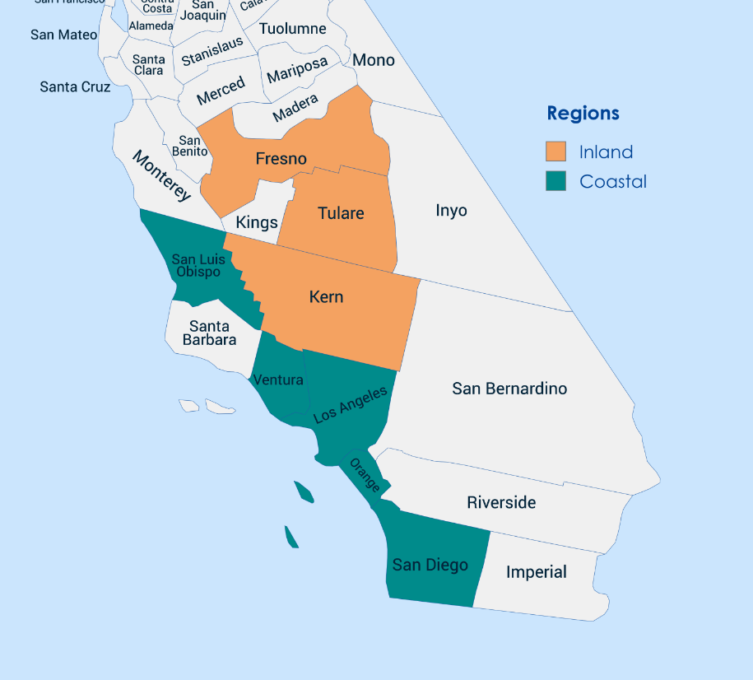
Takeaways, Next Steps
Takeaway:
While county-level models may capture local behavior on a deeper level, it seems that the statewide models were able to generalize onto a county level.
Moving forward:
We want to investigate whether geography provides a meaningful grouping for model transfer, especially inland versus coastal counties.
We also plan to further tune our models, feature select, and cross-validate in order to ensure we are using the most effective models before drawing final conclusions.
Notes:
Speaker__Felix___ - takeaways and plans for next week
NEED TO ANSWER STILL:
Do the county patterns differ enough that generalization is not guaranteed?? (look at model results)
Takeaway 1. Statewide models may capture broad seasonality, but county-level models may capture local behavior
Literature supports that localized models are better
Next step: test coastal <-> inalnd transfer and county-to-county transfer
We want to investigate whether geography provides a meaningful grouping for model transfer, especially inland versus coastal counties

Slide 10
Thank You

